Slide 1
Encoding Texts, or A Gentle Introduction to the Text Encoding Initiative (TEI)

Slide 2
Why Mark Up?
Computers can’t meaningfully distinguish:
Parts from wholes
Concepts from texts
Different kinds of texts
But these are the things we care about.

Slide 3
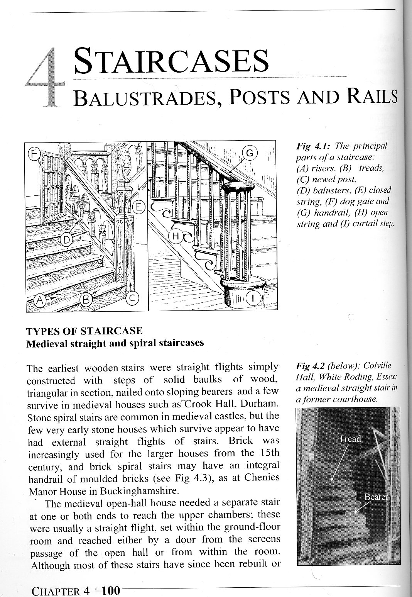
Notes:
A Very Short Introduction to Document Analysis
University of Michigan
http://www.lib.umich.edu/files/departments/dpp/2011TEIWorks.pfs/dox/doc_analysis.html

Slide 4
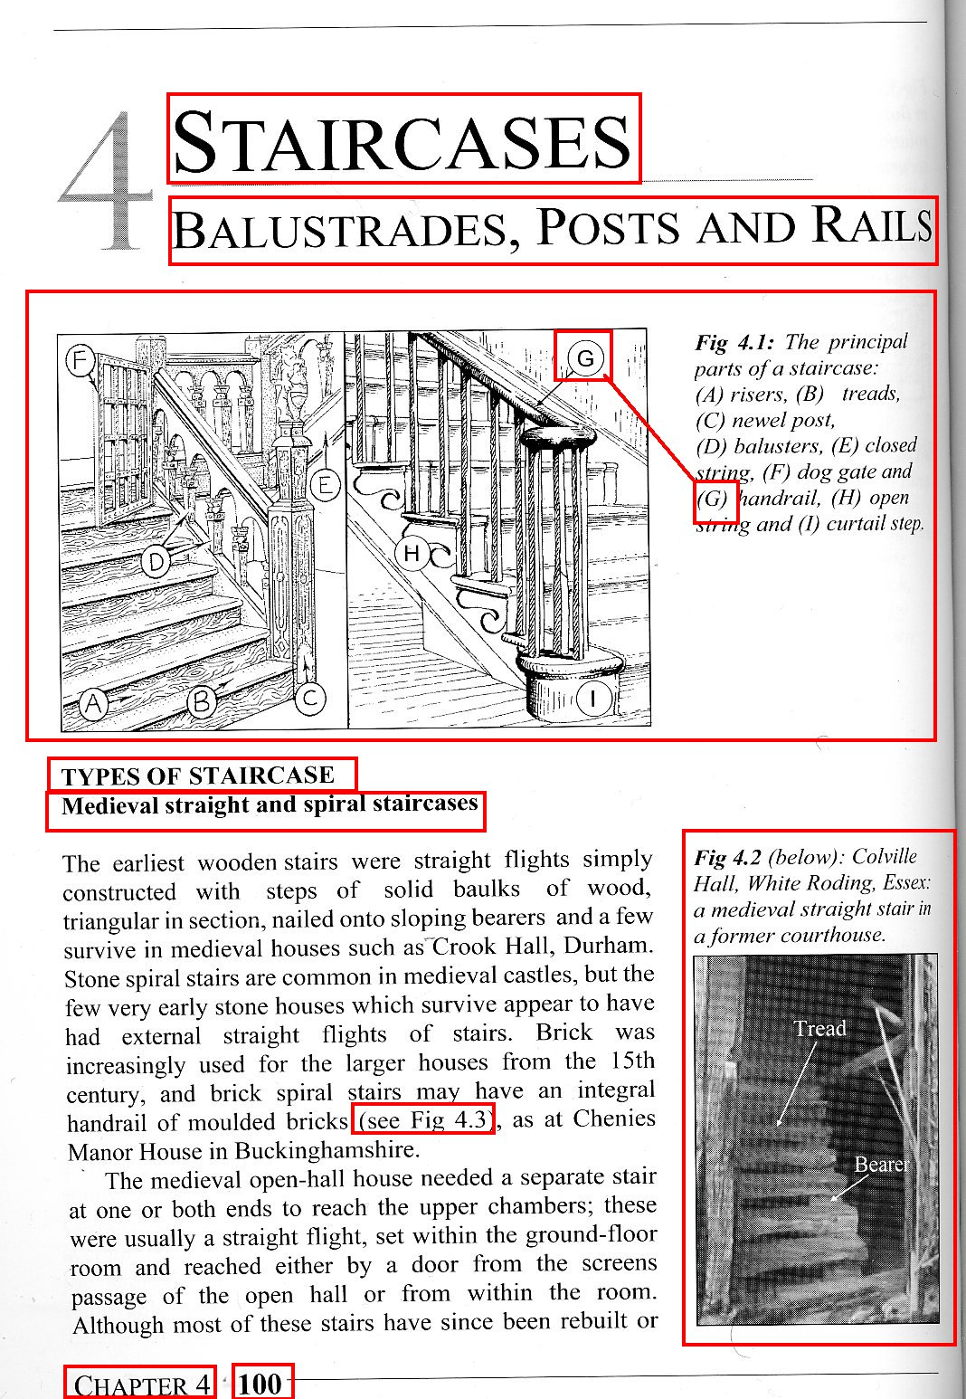
Notes:
A Very Short Introduction to Document Analysis
University of Michigan
http://www.lib.umich.edu/files/departments/dpp/2011TEIWorks.pfs/dox/doc_analysis.html

Slide 5
Activity
Work in your groups to identify all textual and non-textual features of your passage of text.
structural (sentence, etc.)
renditional (italics, etc.)
conceptual (proper nouns, etc.)
Notes:
Equally infinite choices in what to markup. Markup is always interpretation.
You can markup what is there.
You can markup what you choose to find there
You can markup what is only implicitly there (tagging silences)
One can try to distinguish between categories of features (but they are interrelated)
Linguistic features
Presentational features
Structural/rhetorical features
Artefacts of print
Etc.
Mostly you will be responding to obvious physical cues. Asking "what is this thing?" "What is it here for?" "How does it relate to the other things here?" Visual cues aren't everything, they can be misleading, but they are a start. Especially if you are writing instructions for someone else to recognize features.

Slide 6
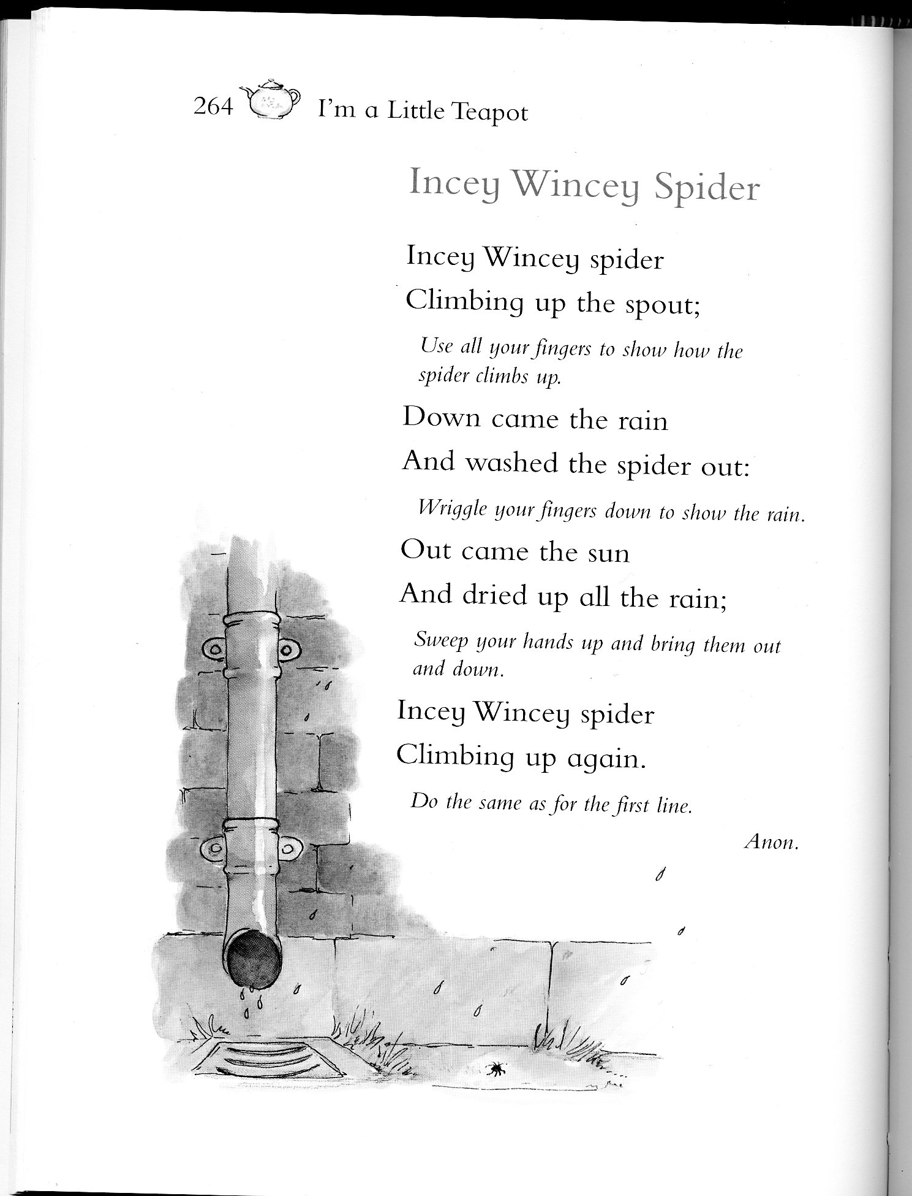
Notes:
A Very Short Introduction to Document Analysis
University of Michigan
http://www.lib.umich.edu/files/departments/dpp/2011TEIWorks.pfs/dox/doc_analysis.html

Slide 7
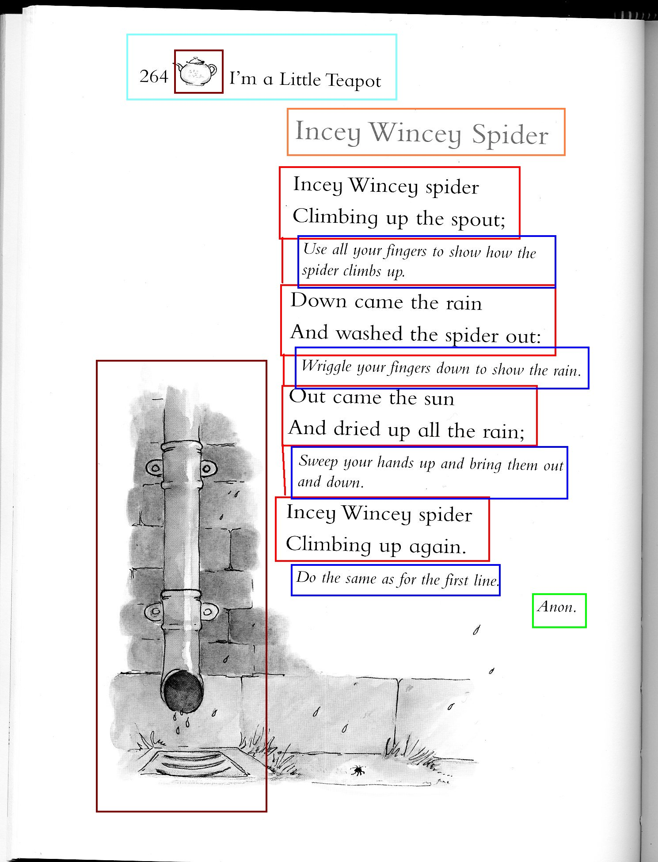
Notes:
A Very Short Introduction to Document Analysis
University of Michigan
http://www.lib.umich.edu/files/departments/dpp/2011TEIWorks.pfs/dox/doc_analysis.html

Slide 8
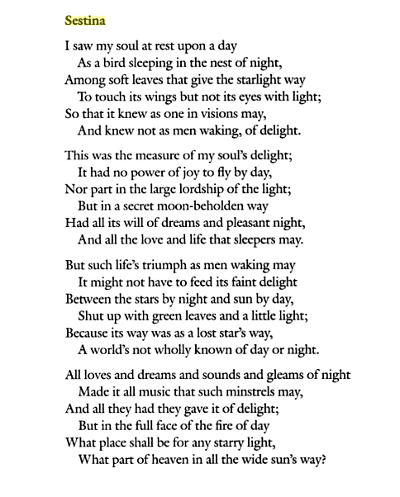
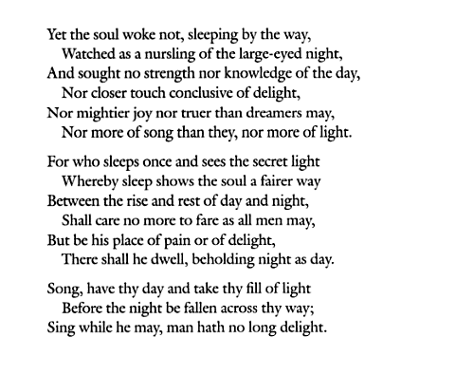
Swinburne, Algernon C, and Jerome J. McGann. Major Poems and Selected Prose. New Haven: Yale Univ. Press, 2004. 160-1. Print.
Notes:
Example from Poetry

Slide 9
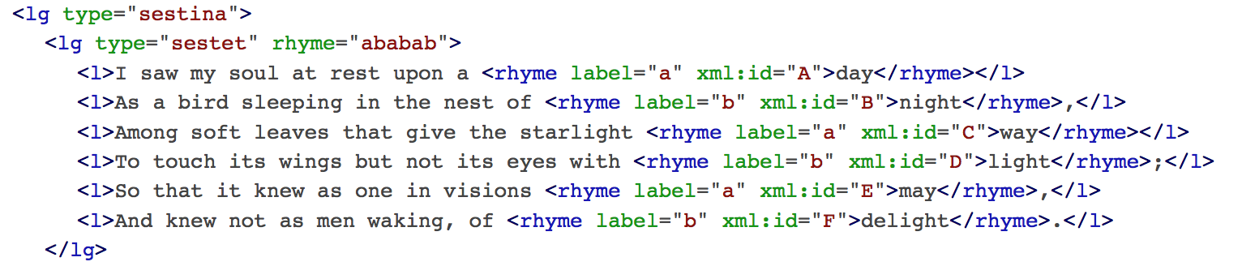
http://www.teibyexample.org crafted example encoding of Sestina. In: Swinburne, Algernon Charles (1924), Swinburne's Collected Poetical Works. London: William Heinemann, 330-31.
Notes:
Note the tags bit.

Slide 10
<lg type=“stanza”>
<l> a line </l>
<l> another line </l>
<l> still another line </l>
</lg>
Note: tags are often intuitive.
<lg> = line grouping
<l> = line

Slide 11
Markup Continued
Markup is always interpretation.
You can markup what is there.
You can markup what you choose to find there
You can markup what is only implicitly there (tagging silences)

Slide 12
Markup Continued
Asking "what is this thing?"
"What is it here for?"
"How does it relate to the other things here?"
A way of connecting human interpretation to machine

Slide 13
Why Markup?
Allows you to ask a computer questions that it couldn’t answer before.
Now we can say things like:
Show us all the rhyming words.
Show us all the ending lines for a stanza
Show us all the sonnets
Display particular elements in particular ways on the web.

Slide 14
Question Enabled by Markup
How often is a skull used in stage directions in Hamlet?
Without TEI, searching for “skull” would return instances of skull in the whole play dialogue too
With TEI, we can search specifically within stage directions to find the specific instances we care about.
TEI enables us to distinguish b/w parts of text.

Slide 15
Why TEI Specifically?
First developed in 1987.
Developed by and for humanists.
Community-maintained standards.

Slide 16


Why Standards?
Notes:
Standards allow the work you put into a text to be used by others beyond yourself. It means that your work can contribute to a larger conversation and greater good. Can work in new contexts

Slide 17
Standards Continued
<l>
<line>
<ln>
All could mean the same thing to a human.
A computer wouldn’t associate them / would need an extra step to connect them all.

Slide 18
Standards
Your work can be sustained by others.
Your work can be used by others.
Your work can be built upon by others.
The key here: “by others.”
Standards mean that you’re thinking beyond yourself and beyond the present.

